Slide 1
Chapter 2
HYPERTEXT TRANSFER PROTOCOL (HTTP)

Slide 2
WWW
World Wide Web—a repository of Information
Introduced in 1991
Originated from the CERN High-Energy Physics laboratory in Geneva, Switzerland.
Purpose—create a system to handle distributed resource
A client-server service
Service provider—called website

Slide 3
The Web: Some Basic Concepts
Web page
  consists of objects (HTML file, JPEG image, GIF image…)
  addressed by URL
Most Web pages consist of
  base HTML page
  several referenced objects—Hypertext and Hepermedia
URL
  A standard way of specifying the location of an object, typically a web page, on the Internet
User agent for Web is called a browser
  MS Internet Explorer
  Opera
  Netscape Navigator
  Mozilla
  Konquor
  Google Chrome
Server for Web is called a Web server

Slide 4
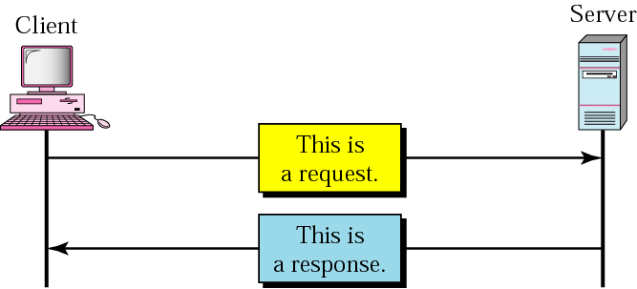
Hypertext Transfer Protocol
Web’s application layer protocol
  Used to access data on the World Wide Web
  Rapid jump from one document to another
Client-server model
  client: browser that requests, receives, “displays” web objects
  server: Web server sends objects in response to request
uses TCP connection on the well-known port 80

Slide 5
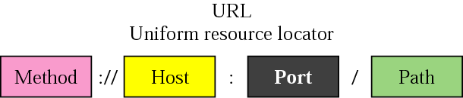
URL
An address of the web page or other information on the Internet
Example
  http://www.yahoo.com/
  http://www.jusl.ac.in/images/sitemap.gif
  http://www.foldoc.org/?Uniform+Resource+Locator
  http://mail.jusl.ac.in/
  http://www.it.site.jusl.ac.in:8081/jsp/test.jsp
  ftp://wuarchive.wustl.edu/mirrors/msdos/graphics/gifkit.zip

Slide 6
URL - continued
Method
  protocol used to retrieve the document (FTP, HTTP, …)
Host
  a computer where the info is located
  the name/IP address of the computer can be an alias (not necessary www)
Port
  optional port # of the server (default is 80)
Path
  the path name of the file where the info is located

Slide 7
HTTP - example
Suppose user enters URL www.yahoo.com/index.html
1. http server is created at port 80 which waits for TCP connection to be established by the clients
2a. http client initiates TCP connection to http server (process) at www.yahoo.com. Port 80 is the default for http server
2b. http server at host www.yahoo.com waiting for TCP connection at port 80 “accepts” connection, notifying client
3. http client sends http request message (containing URL) into TCP connection socket
4. http server receives request message, forms response message containing requested object (index.html), sends message into socket
time

Slide 8
HTTP – example (cnt’d)
5. http server closes TCP connection
6. http client receives response message containing html file, parses html file (using browser), finds embedded image, and finally displays in the browser
7. steps 1-5 repeated for another resource
time

Slide 9
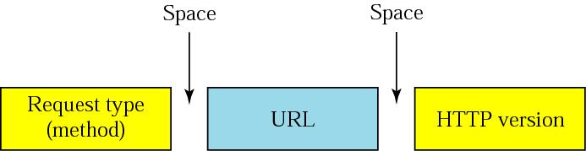
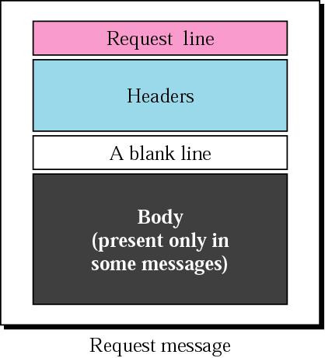
HTTP protocol – message format
two types of messages: request & response
HTTP request message
HTTP/0.9 HTTP/1.0 HTTP/1.1
GET – when the client wants to retrieve a document from the server
HEAD – when the client wants some info about a document but not document itself
COPY – copies the file to another location

Slide 10
Other Request type (method)
Method | Description
POST | Used to provide information (e.g. input) to the server
PUT | Used to provide a new or replacement document to be stored on the server
PATCH | Similar to PUT except that the request contains only list of differences that should be implemented in the existing file
MOVE | Used to copy a file to another location
DELETE | Used to remove a document from the server
LINK | Used to create a link or links of a document to another location
UNLINK | Used to delete link created by LINK
OPTION | Used by the client to ask the server about available options

Slide 11
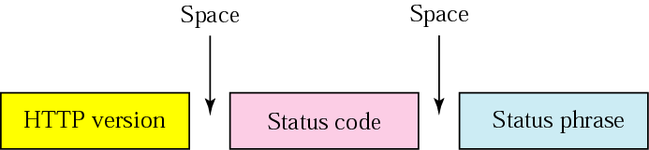
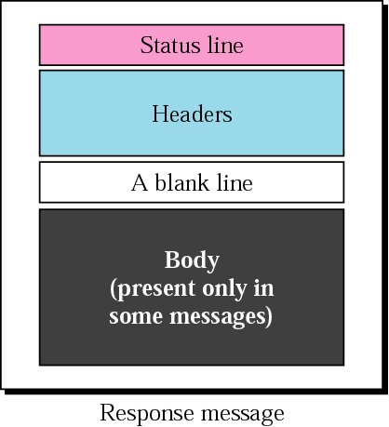
HTTP – message format
HTTP response message
http://www.w3.org/Protocols/HTTP/HTRESP.html
explains the status code
in text form
200 OK – request succeeded
301 Moved Permanently – object moved
400 Bad Request – not understood by server
404 Not Found – req. document not found

Slide 12
HTTP – message format (Status code)
100 range | Informational
200 range | Successful request
300 range | Redirectional
400 range | Client Error
500 range | Server Error

Slide 13
HTTP – message format (Status code)
Code | Phrase | Description
Informational
100 | Continue | The initial part of the request has been received and the client may continue with its request
101 | Switching | The server is complying with a client request to switch protocols defined in the upgrade header
Success
200 | OK | The request is successful
201 | Created | A new URL is created
202 | Accepted | The request is accepted, but it is not immediately acted upon
204 | No content | There is no content in the body
Redirection
301 | Multiple choices | The requested URL refers to more than one request
302 | Moved permanently | The requested URL is no longer used by the server
304 | Moved temporarily | The requested URL has moved temporarily

Slide 14
HTTP – message format (Status code)
Code | Phrase | Description
Client Error
400 | Bad Request |  | There is a syntax error in the request
401 | Unauthorized |  | The request lacks proper authorization
403 | Forbidden |  | Service is denied
404 | Not found |  | The document is not found
405 | Method not allowed |  | The method is not supported in this URL
406 | Not acceptable |  | The format request is not acceptable
Server Error
500 | Internal Server Error | There is an error, such as crash, the server side
501 | Not Implemented | The action requested can not be performed
503 | Service unavailable | The service is temporarily unavailable, but may be requested in the future

Slide 15
HTTP – message format
HTTP response message

Slide 16
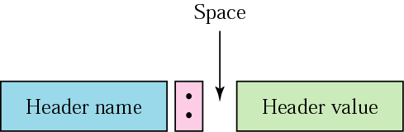
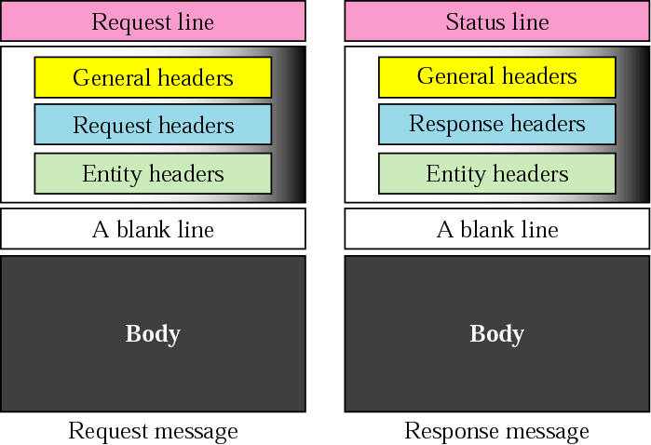
HTTP – message format
Headers
  exchange additional information between the client & the server
  example
    Date
    Client’s email address
    Document age
    Content length

Slide 17
HTTP – message format
General Header
Header | Description
Cache-control | Specifies information about caching
Connection | Shows whether the connection should be closed or not
Date | Shows the current date
MIME-version | Shows the MIME version used
Upgrade | Specifies the preferred communication protocol

Slide 18
HTTP – message format (Request Header)
Header | Description
Accept | Shows media format the client can accept
Accept-charset | Shows the character set the client can handle
Accept-encoding | Shows the encoding scheme the client can handle
Accept-language | Shows the language the client can accept
Authorization | Shows the permission the client has
From | Shows the email address of the user
Host | Shows the host and port number of the client
If-modified-since | Send the document if newer than specified date
If-match | Send the document only if matches given tag
If-non-match | Send the document only if does not match given tag
If-range | Send only the portion of the document that is missing
If-unmodified-since | Send the document if not changed since specified date
Referrer | Specifies the URL of the linked document
User-agent | Identifies the client program

Slide 19
HTTP – message format (Response Header)
Specifies the server’s configuration and special information about the request
Header | Description
Server | Shows the server name and version number
Age | Shows the age of the document
Public | Shows the supported list of methods
Retry-after | Specifies the date after which the server will be available
Accept-range | Shows if server accepts the range requested by client

Slide 20
HTTP – message format (Entity Header)
Specifies information about the body
Header | Description
Allow | List of valid methods that can be used with a URL
Content-encoding | Specifies the encoding scheme
Content-language | Specifies the language
Content-length | Shows the length of the document
Content-range | Specifies the range of the document
Content-type | Specifies the media type
Etag | Gives an entity tag
Expires | Gives the date and time when contents may change
Last-modified | Gives the date and time of the last change
Location | Specifies the location of the created of moved document

Slide 21
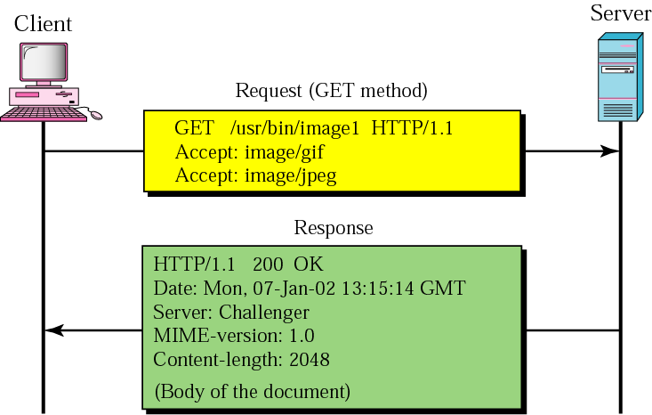
HTTP messages – an example
This example retrieves a document.
We use the GET method to retrieve an image with the path /usr/bin/image1.
The request line shows the method (GET), the URL, and the HTTP version (1.1).
The header has two lines that show that the client can accept images in GIF and JPEG format.

Slide 22
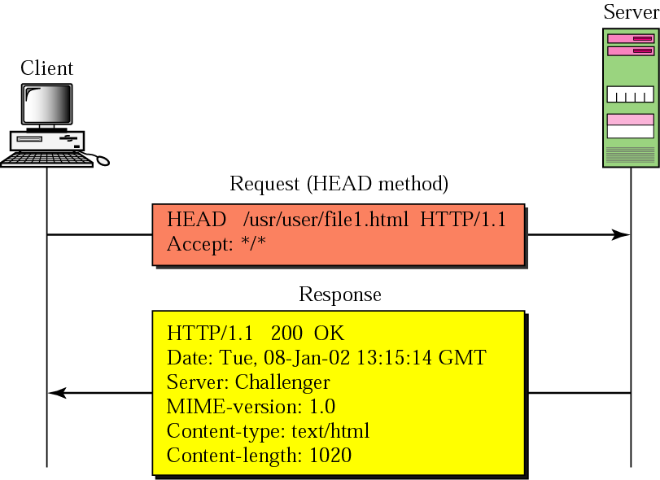
HTTP messages – an example
This example retrieves information about a document. We use the HEAD method to retrieve information about an HTML document

Slide 23
Persistent and nonpersistent connections
Nonpersistent
  HTTP 1.0
  one TCP connection for each request/response
  the client opens a TCP connection and sends a request
  the server sends the response and closes the connection
  the client reads data and closes the connection
  each object transfer is independent
Persistent
  default for HTTP 1.1
  the server leaves the TCP connection open for more requests after sending a response
  client sends requests for all referenced objects as soon as it receives base HTML
    pipelining
  fewer RTT

Slide 24
Web caches - Proxy
HTTP supports Proxy servers
Proxy server
  a computer that keeps copies of responses to recent requests
Goal: satisfy client request without involving original server
Origin server
client sends all http requests to the proxy server
if object at web cache sends the object in http response
else request object from the origin server, then returns http response to client
http response
Proxy server
client
http request
http response
http request
client
Origin server

Slide 25
Why Web caching?
Assume: cache is closed to a client (in the same network)
  smaller response time (improved latency)
  decrease traffic to distance servers
    link out of ISP network is often a bottleneck
the Internet
1.544 Mbps link
institutional network
10 Mbps LAN
institutional cache

Slide 26
Consistency of Web caching
The major issue: How to maintain consistency?
Two ways:
  Pull
    Web caches periodically pull the web server to see if a document is modified
  Push
    Whenever a server gives a copy of a web page to a web cache, they sign a lease with an expiration time; if the web page is modified before the lease, the server notifies the cache

